Slide 1
DAA Assignment 1 - Group 17

Slide 2
Question
Given an array of randomly generated positive integers of size 1000 such that, elements of the array range from 10000 to 1000000. Locate the smallest prime number.

Slide 3
Abstract
The problem is to find the smallest prime number in a given array. There are many algorithms to solve the above problem. We have to select the one which has least time complexity. For this we use the algorithm named Sieve of Eratosthenes. In this algorithm we precompute the prime numbers up to the maximum number of the array. Precomputation includes creating a boolean array and then the array block corresponding to a prime index is set to true. Then we check each number of the array whether it is prime or not and then find the minimum of the prime numbers. The time complexity of the above code is max(log(log(max)), where max is the largest number in the array.

Slide 4
KeyWords
Prime: A number is said to be prime, if it is divisible only by 1 and itself.

Slide 5
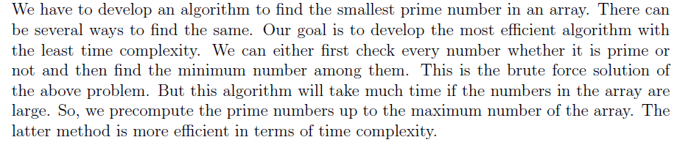
Literature Survey

Slide 6
IDEA
Here we have used the popular algorithm 'Sieve of Eratosthenes' for finding smallest prime number in a given array.
A number is prime, if none of the smaller prime numbers divides it. Since we iterate over the prime numbers in order, we already marked all numbers, which are divisible by at least one of the prime numbers. Hence if we reach a cell and it is not marked, then it isn't divisible by any smaller prime number and therefore has to be prime.
We have first calculated the maximum number in the input array and used the algorithm for marking prime numbers in array of size equal to that number. Then among the prime numbers we found the minimum number.

Slide 7
Algorithm Design – a. Using Brute Force – O(n*sqrt(max))
Parameters -
n: Size of the given array.
a[]: Array of size n.
Variables -
flag: set when a number is composite.
min: stores the minimum number
i: used for storing array index
j: used for iterating over numbers up to n

Slide 8
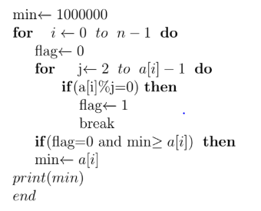
Pseudo Code

Slide 9
Part b: Using Sieve
Parameters-
n: Size of the given array.
a[]: Array of size n.
Variables
max: stores the maximum number in the array
min: stores the smallest prime number int the array(if exists)
i: used for storing array index
j: used for iterating over numbers up to n
prime[]: boolean array which stores true if the number is prime
ans: stores the final answer

Slide 10
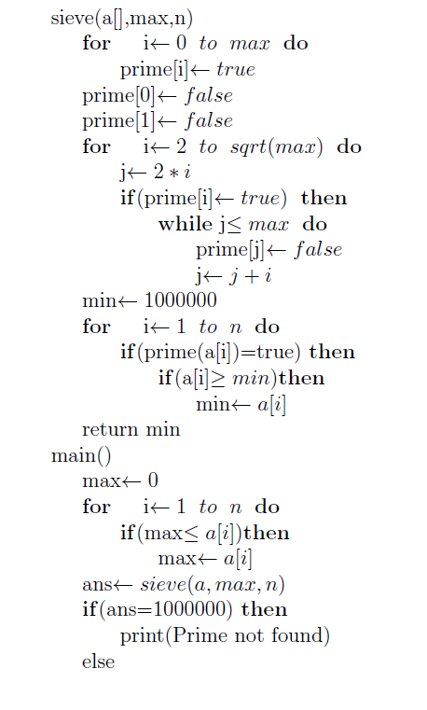
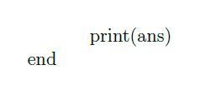
Psuedo Code

Slide 11
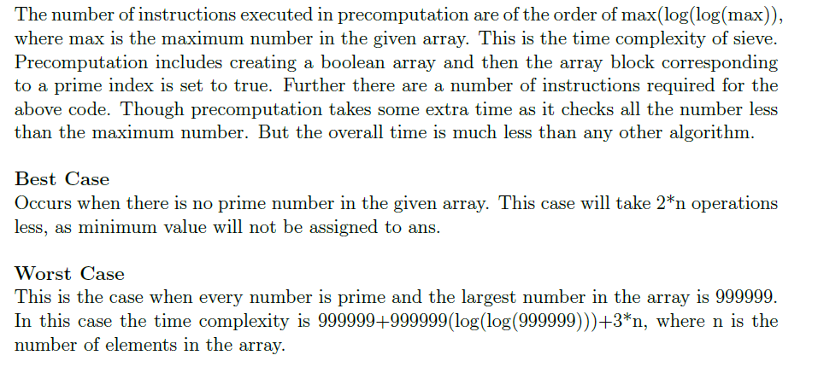
Analysis and Discussion – Time Complexity

Slide 12
Example – For best Case Scenario
Every number in the array is a composite number, i.e. there is no prime number.
For eg. – There is an array of 10 numbers –
86810, 86712, 11116, 49909, 99000, 11112, 77638, 90102, 12055, 26565
In above example, there is no prime, thus we do not need to compute the minimum value every time.

Slide 13
Example – Worst Case Scenario
When every number is a prime, and the numbers are arranged in descending order.
Eg. – 20341, 20333, 20323, 20011, 19919, 18913, 17489, 16699, 14957, 13799
In above example, since all the number are prime, we first store the value of first prime in a variable, and then keep checking everytime if the next prime is a smaller number. Since the new number is smaller than the previous one, we have to update the value everytime, thus taking more time.

Slide 14
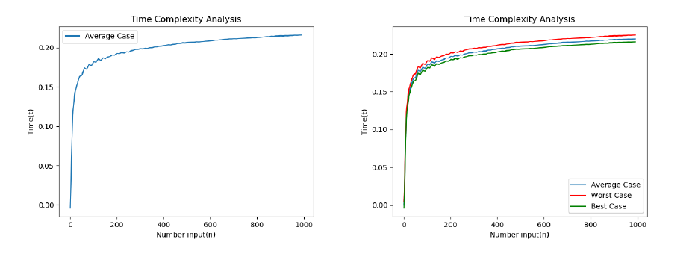

Slide 15
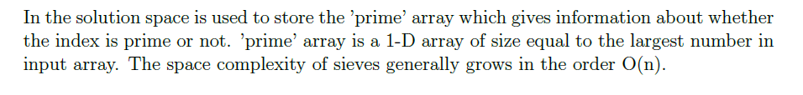
Analysis of Space Complexity

Slide 16
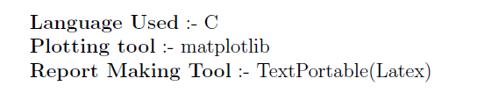
Experimental Setup

Slide 17
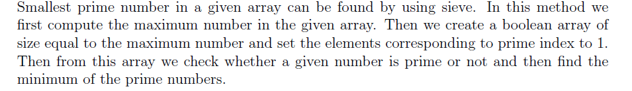
Conclusion

